Slide 1












AI-DOCHELPER
GUIDE : | GROUP NO : | GROUP MEMBERS :
PROF. AEJAZ KHAN | 43 | VIKRANT SHAH
 |  | SURBHI SINGH
 |  | ANUJA KOTHAVALE

Slide 2
INTRODUCTION
For many years, many people have died due to undetected diseases. Early detection of these diseases at the micro classification stage can be useful for providing proper treatment to the patients at the early stage and could have saved a lot of lives. A lot of research is being done to detect these diseases at the earliest.

Slide 3
PROBLEM STATEMENT
AI-DocHelper, an artificial intelligence-based system.
The model that gives the best accuracy and minimum loss.
The output of Final result will be a prediction.

Slide 4
REQUIREMENTS
Hardware Requirements :
Processor : Intel Core i3 / Pentium
RAM : 4 GB Minimum
Hard Disk Space : 30 GB Minimum

Slide 5
REQUIREMENTS
Software Requirements :
Operating System : Windows / MacOS / Linux
Browser : Google Chrome / Mozilla Firefox
Software Libraries : Python 3.x, Tensorflow 2.0, Annaconda, Jupyter Notebook, Numpy, Pandas, Scikit-learn, Flask/Django

Slide 6
FEATURES
Early detection of disease
User friendly GUI
Precise results
User Data Store

Slide 7
WHY AI-DOCHELPER ?
Existing system available are able to detect only one or two diseases.
Everything in the future will be automated.

Slide 8
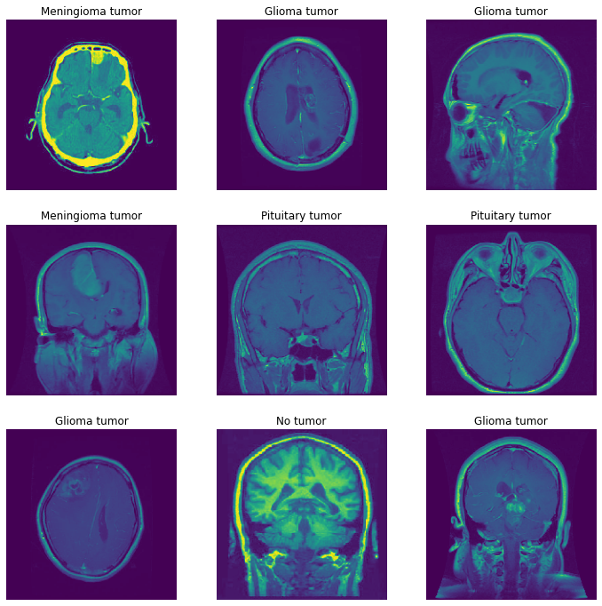
DATASETS
Brain Tumor Classification (MRI) Dataset : 3624 samples and 4 classes(No Tumor, Glioma Tumor, Meningioma Tumor, Pituitary Tumor)

Slide 9
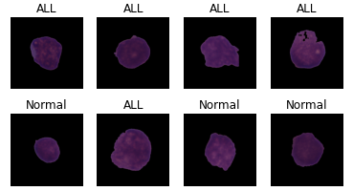
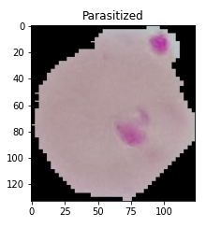
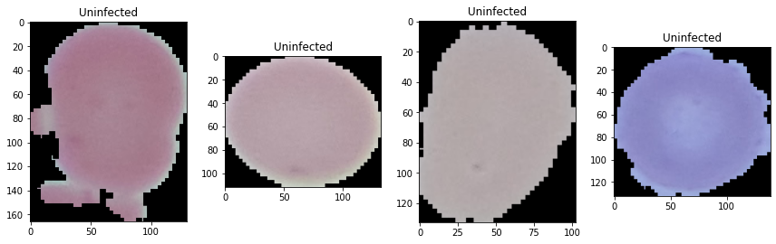
DATASETS
Leukemia Classification Dataset : 3527 samples and 2 classes(ALL, HEM)
Malaria Cell Image Dataset : 27.6k samples and 2 classes (Uninfected, Parasitized)

Slide 10
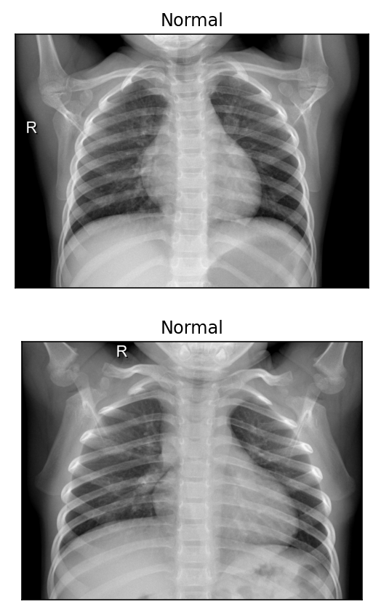
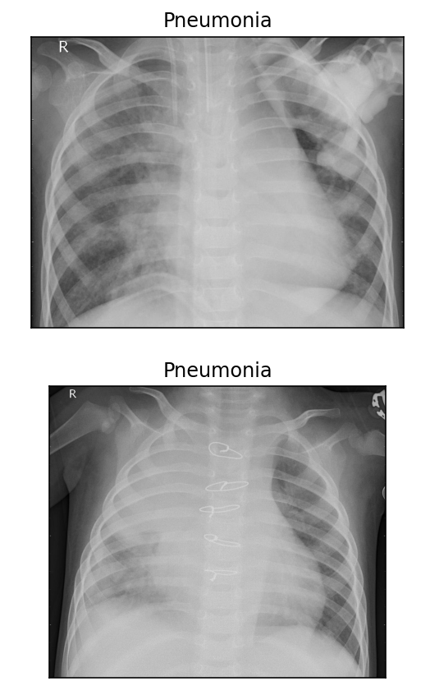
DATASETS
Pneumonia X-ray Images Dataset : 5856 samples and 2 classes (normal, opacity)
And many more…

Slide 11
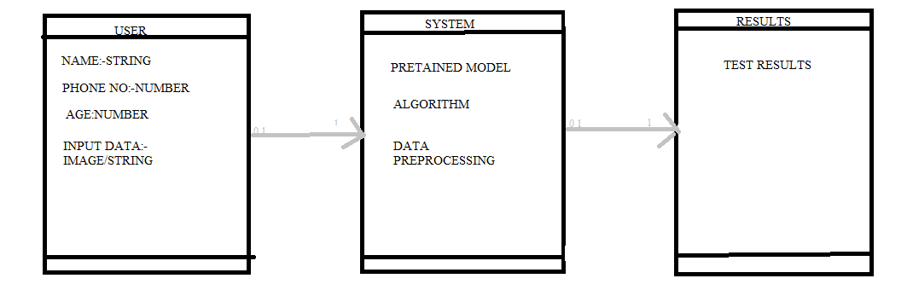
CLASS DIAGRAM

Slide 12
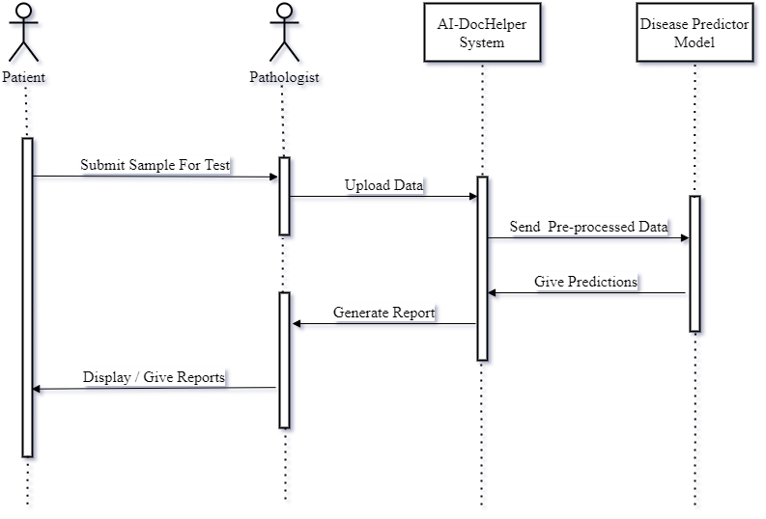
FLOW OF EVENTS

Slide 13
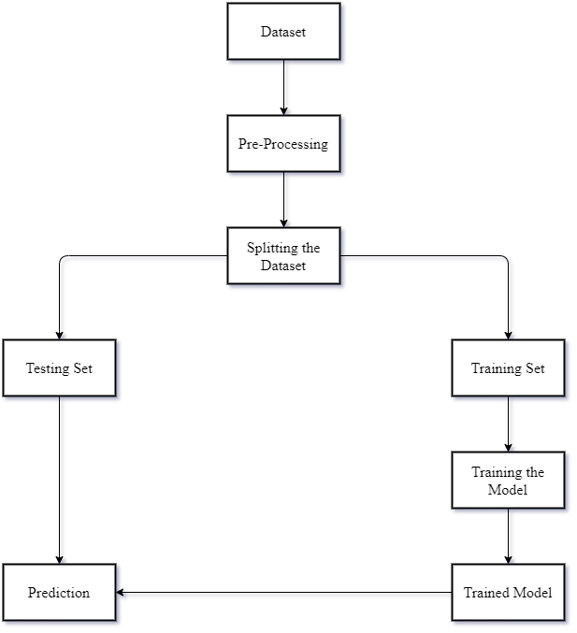
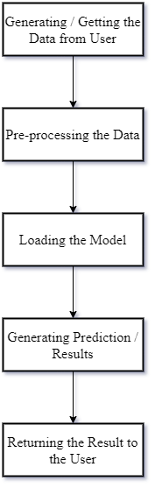
PROPOSED SYSTEM : WORKFLOW

Slide 14
PRE-PROCESSING THE TEXTUAL DATASET
Dropping the unnecessary fields.
Replacing all the missing fields with a value.
Scaling the data
Converting categorical data to numeric data.

Slide 15
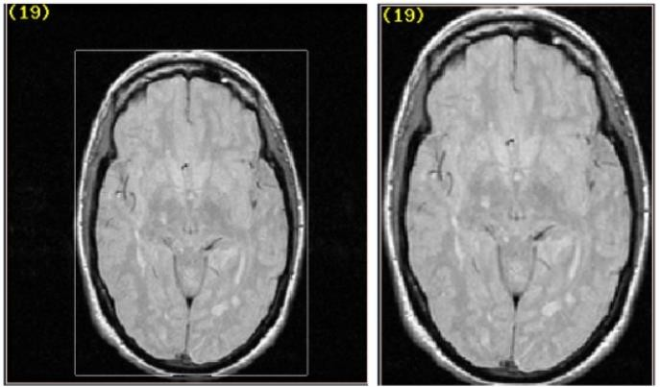
PRE-PROCESSING THE IMAGE DATASET
Dropping all the blur images.
Region of Interest
Filtering & Smoothing an image.
Getting the Region of Interest / Volume of Interest.

Slide 16
COMPARATIVE STUDY FOR TEXTUAL DATASET
Pima Indian Diabetes Database / Dataset
Originally from the National Institute of Diabetes and Kidney Diseases
Published by UCI Machine Learning
Dataset Fields : Pregnancies, Glucose BloodPressure), SkinThickness, Insulin, BMI, DiabetesPedigreeFunction, Age, Outcome

Slide 17
COMPARATIVE STUDY FOR TEXTUAL DATASET
MODEL | ACCURACY
Logistic Regression | 82.46%
K-Nearest Neighbour Classifier | 79.87%
Support Vector Classifier | 82.46%
Naïve Bayes | 79.22%
Decision Tree Classifier | 70.77%
Random Forest Classifier | 82.46%
Artificial Neural Network | 70.77%

Slide 18
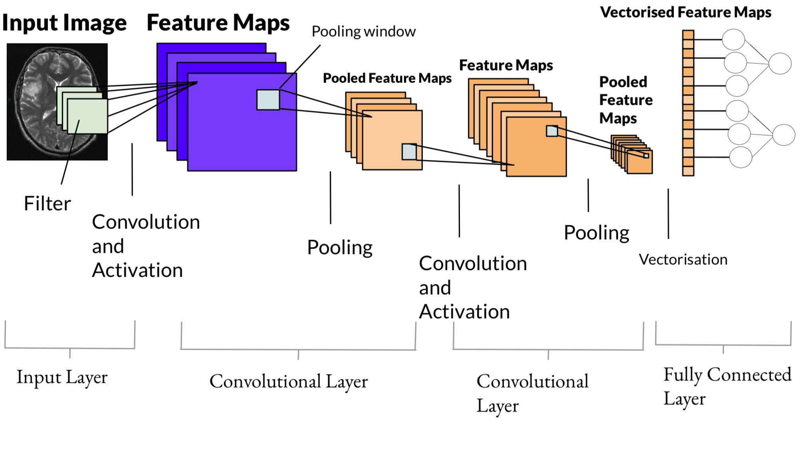
STUDY FOR IMAGE DATASET
Convolutional Neural Network (CNN) with Transfer Learning will be used.

Slide 19
RESULTS AND EVALUATION

Slide 20
Disease Name | Training Accuracy | Training Loss | Testing Accuracy | Testing Loss
Breast Cancer | 87.36% | 31.24% | 85.49% | 38.67%
Pneumonia | 95.86% | 10.92% | 98.25% | 14.88%
Glioma Tumor | 92.20% | 19.64% | 92.41% | 19.73%
Meningioma Tumor | 93.19% | 18.18% | 90.52% | 21.80%
Diabetes | 82.40% | 23.10% | 80.52% | 25.13%
Pituitary Tumor | 99.06% | 3.33% | 98.85% | 3.03%
Melanoma (Skin) Cancer | 85.12% | 31.37% | 83.87% | 33.26%
Acute Lymphoblastic Leukemia (ALL) | 84.14% | 37.54% | 70.43% | 58.85%
Heart Disease | 91.37% | 25.13% | 88.97% | 28.83%
Chronic Kidney | 89.63% | 19.53% | 86.63% | 21.53%
Malaria | 89.69% | 26.80% | 90.49% | 24.19%
Brain Tumor | 89.21% | 28.49% | 66.67% | 33.72%
Lung Cnacer | 94.41% | 13.80% | 95.26% | 11.60%
Invasive Ductal Carcinoma (IDC) | 80.57% | 43.16% | 78.70% | 47.90%
Tuberculosis | 96.69% | 9.75% | 95.64% | 11.64%
COVID-19 | 86.56% | 33.12% | 86.90% | 32.88%

Slide 21
TOOLS & DESIGN
Web-Based System
Tools suitable for design.
Advantage over other tools.

Slide 22
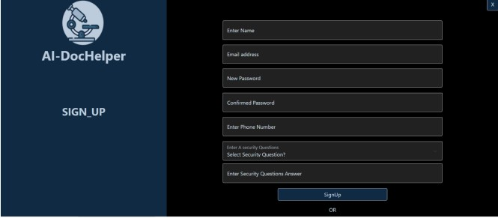
AUTHENTICATION & ACCESSBILITY
Only registered user can access the system.
Uses SQLAlchemy to connect to database.
Provides security.

Slide 23
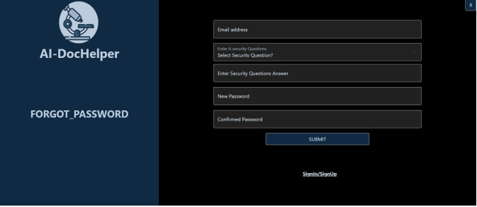
UPDATION IN USER DETAILS
What if user forgets password
Provides easy modifications in users details.
Commits the changes in database and allows accessing
system with new details.

Slide 24
CONCLUSION
Better than many systems available in the market as it can detect many diseases.
Will help to save many lives with precision.
Human errors will be reduced to a great extent.
Course of treatment can be planned very quickly.

Slide 25
REFERENCES
R. Sangeetha and K. S. Murthy, "A novel approach for detection of breast cancer at an early stage using digital image processing techniques," 2017 International Conference on Inventive Systems and Control (ICISC), Coimbatore, 2017, pp. 1-4, doi: 10.1109/ICISC.2017.8068625.
Y. Lu, J. Li, Y. Su and A. Liu, "A Review of Breast Cancer Detection in Medical Images," 2018 IEEE Visual Communications and Image Processing (VCIP), Taichung, Taiwan, 2018, pp. 1-4, doi: 10.1109/VCIP.2018.8698732.
S. Nayak, S. Kumar and M. Jangid, "Malaria Detection Using Multiple Deep Learning Approaches," 2019 2nd International Conference on Intelligent Communication and Computational Techniques (ICCT), Jaipur, India, 2019, pp. 292-297, doi: 10.1109/ICCT46177.2019.8969046.
X. Zeng, H. Chen, Y. Luo and W. Ye, "Automated Diabetic Retinopathy Detection Based on Binocular Siamese-Like Convolutional Neural Network," in IEEE Access, vol. 7, pp. 30744-30753, 2019, doi: 10.1109/ACCESS.2019.2903171.
T. J. Wroge, Y. Özkanca, C. Demiroglu, D. Si, D. C. Atkins and R. H. Ghomi, "Parkinson’s Disease Diagnosis Using Machine Learning and Voice," 2018 IEEE Signal Processing in Medicine and Biology Symposium (SPMB), Philadelphia, PA, 2018, pp. 1-7, doi: 10.1109/SPMB.2018.8615607.
Y. Liu et al., "Detecting Diseases by Human-Physiological-Parameter-Based Deep Learning," in IEEE Access, vol. 7, pp. 22002-
22010, 2019, doi: 10.1109/ACCESS.2019.2893877.
A. Shrivastava, I. Jaggi, S. Gupta and D. Gupta, "Handwritten Digit Recognition Using Machine Learning: A Review," 2019 2nd International Conference on Power Energy, Environment and Intelligent Control (PEEIC), Greater Noida, India, 2019, pp. 322- 326, doi: 10.1109/PEEIC47157.2019.8976601.

Slide 26
THANK YOU

